Slide 1
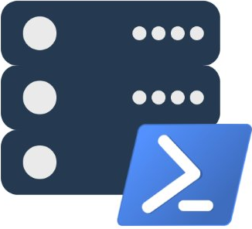
dbatools ❤ SQL Server
Presented by
Chrissy LeMaire, MVP
chrissy lemaire, mvp: netnerds.net, @cl code: dbatools.io

Slide 2
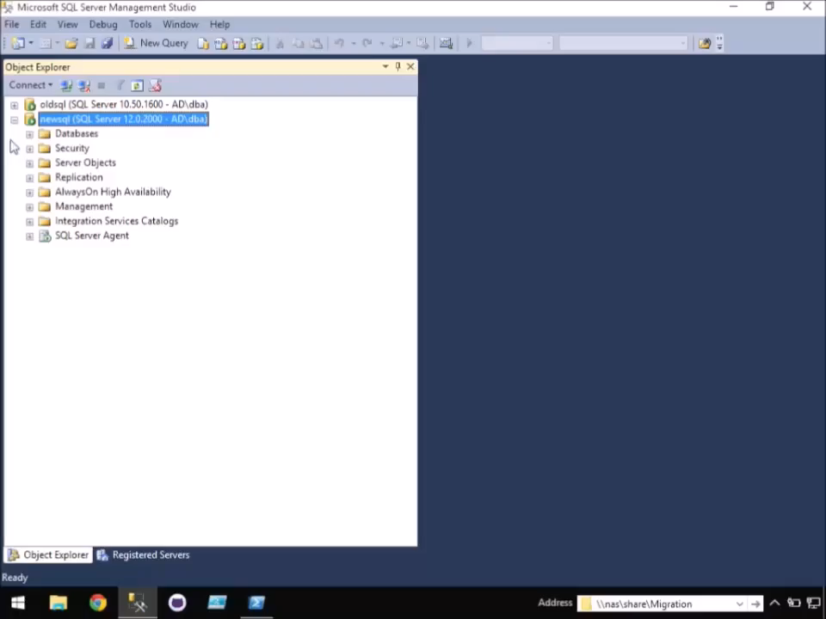
-WhatIf SQL Server Migrations went more like this…
chrissy lemaire, mvp: netnerds.net, @cl code: dbatools.io

Slide 3

Cloud & DataCenter (PowerShell)
Since 2015
chrissy lemaire, mvp: netnerds.net, @cl code: dbatools.io

Slide 4


DBA at NATO Special Ops
chrissy lemaire, mvp: netnerds.net, @cl code: dbatools.io

Slide 5
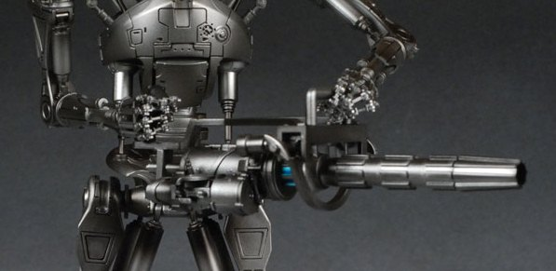
RoboCop’s RBS-80 Heavy Phased Plasma Pulse Gun
chrissy lemaire, mvp: netnerds.net, @cl code: dbatools.io

Slide 6

chrissy lemaire, mvp: netnerds.net, @cl code: dbatools.io

Slide 7

twitter
@cl
chrissy lemaire, mvp: netnerds.net, @cl code: dbatools.io
Notes:
Community project, initially started out as Start-SqlMigration but has grown into a DBA’s best friend. dbatools currently sports 79 commands.
How many of you have heard of dbatools? How many of you have used it? How many knew it was born in Belgium? :D

Slide 8
Agenda - dbatools
Who
Requirements
Hella Demos
1
2
3
4
5
6
Overview
Install
Questions!
chrissy lemaire, mvp: netnerds.net, @cl code: dbatools.io

Slide 9

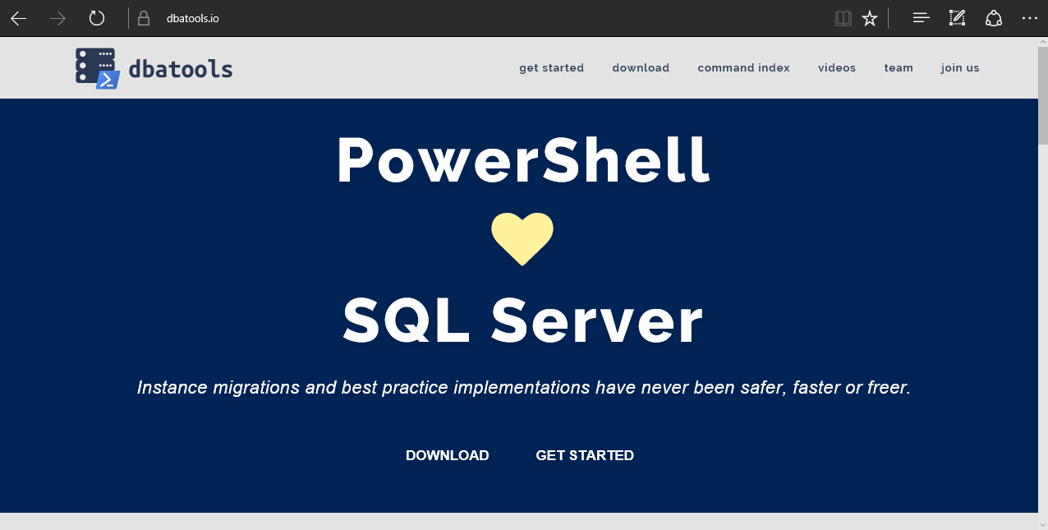
dbatools
chrissy lemaire, mvp: netnerds.net, @cl code: dbatools.io
Notes:
Community project, initially started out as Start-SqlMigration but has grown into a DBA’s best friend. dbatools currently sports 100 commands.
How many of you have heard of dbatools? How many of you have used it?

Slide 10
System Requirements
Minimum
Client
PowerShell v3
SQL Server Management Studio 2008 R2
Server
SQL Server 2000
Recommended
Client
PowerShell v5
SQL Server Management Studio 2012+
Server
SQL Server 2005+
Most dbatools commands do not care about the
version of PowerShell on the server – only client.
chrissy lemaire, mvp: netnerds.net, @cl code: dbatools.io
Notes:
Started as a migration tool, so I strived to support older environments
No reliance on SQLPS, because we’ve got a history ;)

Slide 11
Install is easy
PowerShell Gallery
Install-Module dbatools
Install-Module dbatools –Scope CurrentUser
GitHub – dbatools.io/git
Invoke-Expression (Invoke-WebRequest https://dbatools.io/in)
chrissy lemaire, mvp: netnerds.net, @cl code: dbatools.io
Notes:
Gallery requires admin access and is built into PowerShell v5. Other versions also support it with a bit of configuration.
Download
Unzip
Import-Module

Slide 12
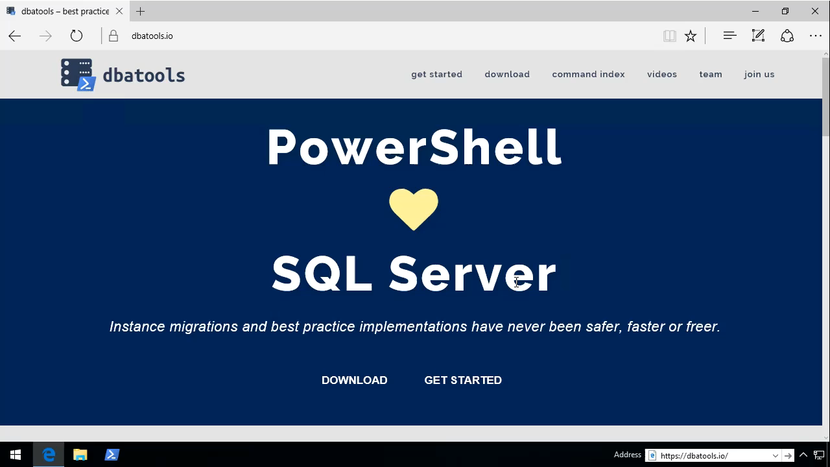
See?
chrissy lemaire, mvp: netnerds.net, @cl code: dbatools.io

Slide 13
Support
We aim for:
SQL Server 2000 – vNext
Express – Datacenter Edition
Clustered and stand-alone instances
Windows and SQL authentication
Default and named instances
Multiple instances on one server
chrissy lemaire, mvp: netnerds.net, @cl code: dbatools.io
Notes:
Gallery requires admin access and is built into PowerShell v5. Other versions also support it with a bit of configuration.
Download
Unzip
Import-Module

Slide 14
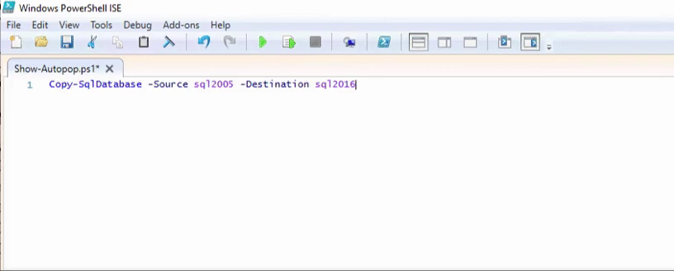
Support
chrissy lemaire, mvp: netnerds.net, @cl code: dbatools.io

Slide 15
Before I begin the demos..
Feature Freeze Coming Soon
March 1 begins a feature freeze, to make way for 1.0
1.0 will be awesome, but will have breaking features
What We’ll Be Doing
Fixing all bugs reported at dbatools.io/issues
Making permissions check more accurate
Standardizing command names, parameter names, help, variables, etc.
Standardizing output – going to all objects and verbose instead of text
Adding more/better pipeline support
Testing, testing, testing
chrissy lemaire, mvp: netnerds.net, @cl code: dbatools.io
Notes:
Gallery requires admin access and is built into PowerShell v5. Other versions also support it with a bit of configuration.
Download
Unzip
Import-Module

Slide 16
Before I begin the demos..
Releases will continue
We will continue to release bug fixes
1.0 will be released on June 1, 2017
Crossing our fingers
chrissy lemaire, mvp: netnerds.net, @cl code: dbatools.io
Notes:
Gallery requires admin access and is built into PowerShell v5. Other versions also support it with a bit of configuration.
Download
Unzip
Import-Module

Slide 17
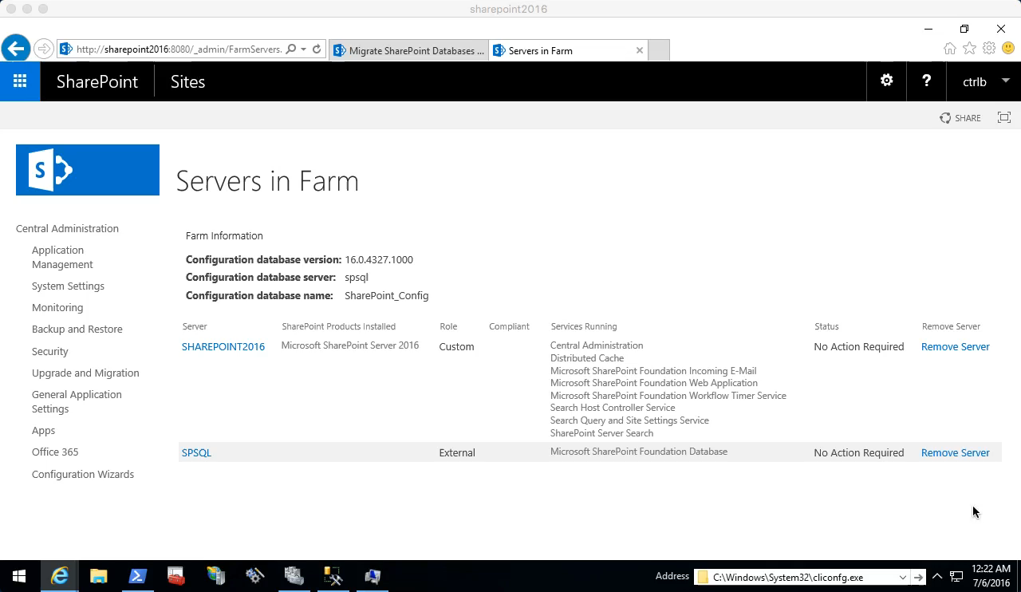
Start-SqlMigration
chrissy lemaire, mvp: netnerds.net, @cl code: dbatools.io

Slide 18

Start-SqlMigration
chrissy lemaire, mvp: netnerds.net, @cl code: dbatools.io

Slide 19
SQL Server Administration and Best Practices
demo
chrissy lemaire, mvp: netnerds.net, @cl code: dbatools.io

Slide 20
How to Get-Help
Extensive documentation within each command Get-Help Start-SqlMigration –Detailed
Extensive documentation on dbatools.io
dbatools.io/Start-SqlMigration
dbatools.io/Repair-SqlOrphanUser
Some commands have videos
dbatools.io/youtube
chrissy lemaire, mvp: netnerds.net, @cl code: dbatools.io

Slide 21
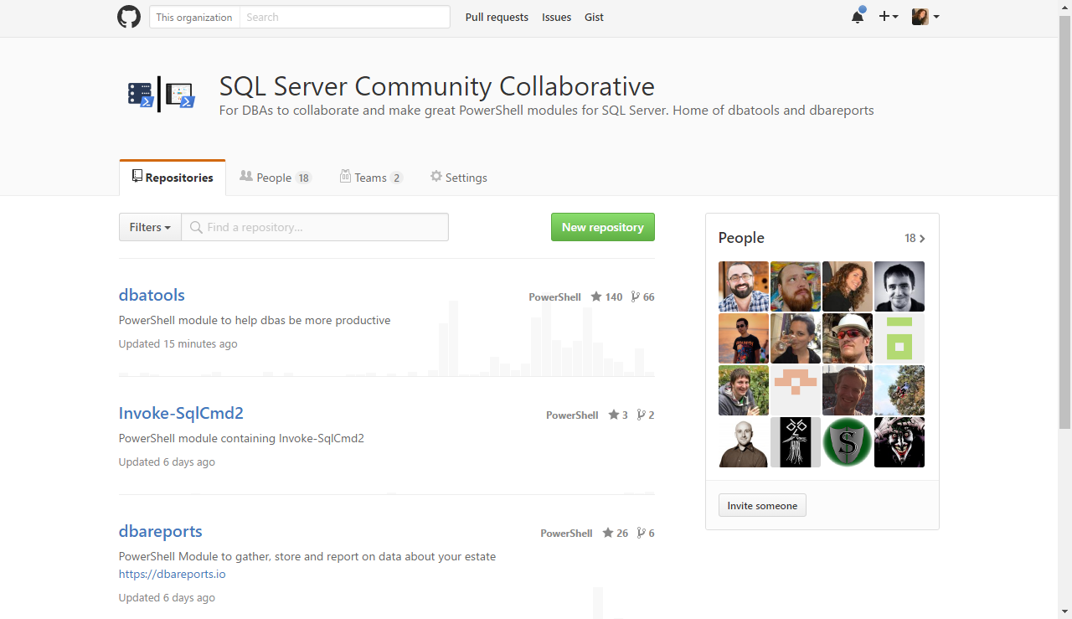
Join us! – github.com/sqlcollaboratve
chrissy lemaire, mvp: netnerds.net, @cl code: dbatools.io

Slide 22
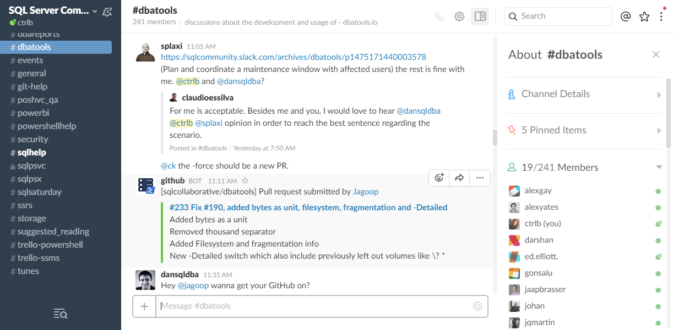
Join us! - dbatools.io/slack
chrissy lemaire, mvp: netnerds.net, @cl code: dbatools.io

Slide 23
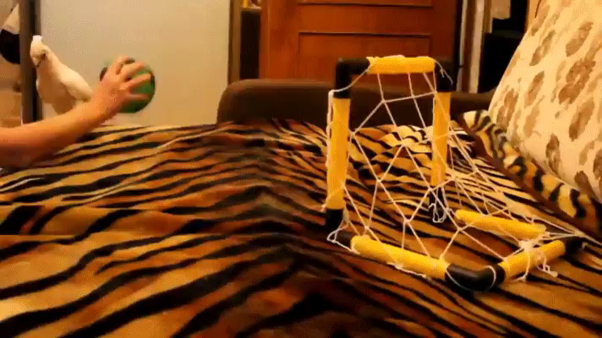
Community got us feelin’ like
chrissy lemaire, mvp: netnerds.net, @cl code: dbatools.io
Notes:
Cut it out.

